Slide 1
WENEST FOOD DELIVERY SYSTEM
YOU ORDER, WE DELIVER

Slide 2
TEAM
Lewis Mwendwa
Scrum Master
Full Stack Developer
Earnest Achayo
Front End Developer
UI/UX Designer
Carlton Agesa
Back end Developer
James Kamuren
UI/UX Designer

Slide 3
After doing research we came into realization that there is a need for a food delivery system to reduce congestion at market places and to also help those who are busy working at home by delivering food to their houses using our web app
Problem Statement

Slide 4

Solution
Our application allows our client to order food online and we deliver immediately Our team is commited to ensure that we deliver as soon as possible to your door step.

Slide 5
Development Process
Testing & Debugging
Designing & Prototyping
Product Ideation
Product Breakdown &
Task Assignment
Implementation

Slide 6



Technologies used

Slide 7
M.V.P
Pairs individuals based on their strengths and weaknesses.

Slide 8
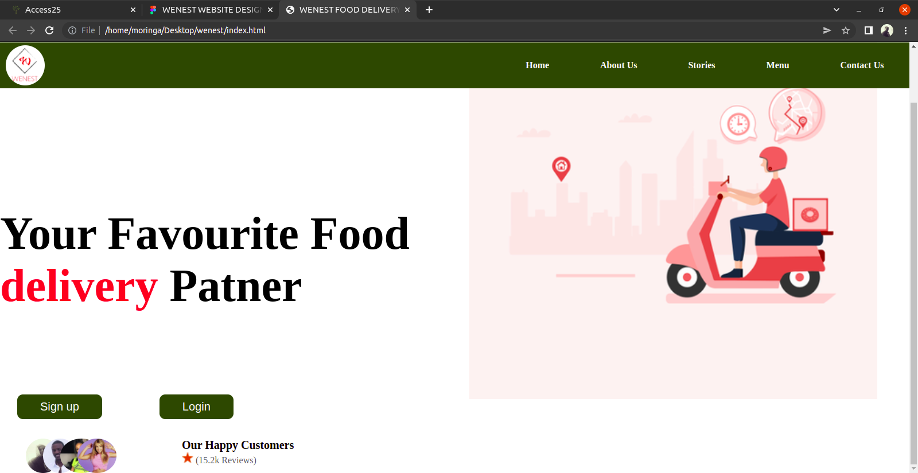
Demo

Slide 9
Challenges Faced
Having to learn new languages in a short span of time.
Responsiveness
Design color implementation

Slide 10
Future Plans
To expand our delivery system outside Nairobi.

Slide 11
Thank You...
Any Questions?

